Slide 1


UNIT 5: Where I live
Self-check 5

Slide 2
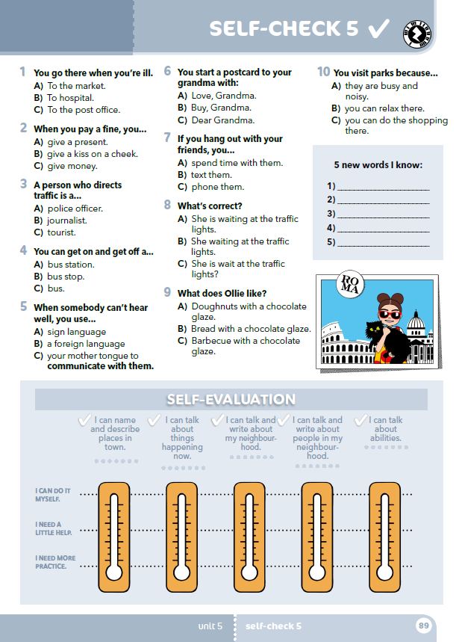
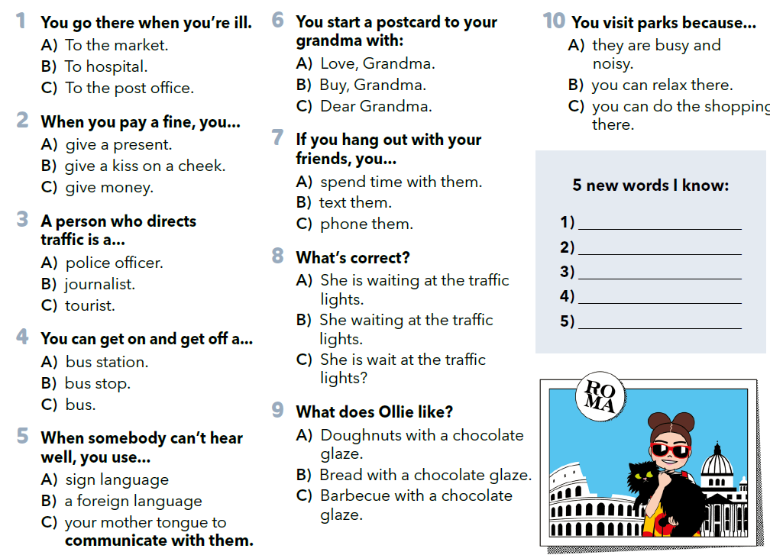

Slide 3
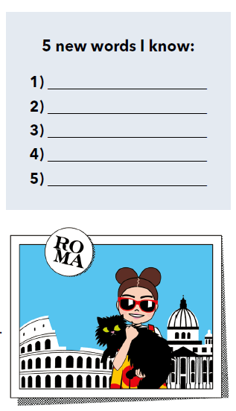

Slide 4
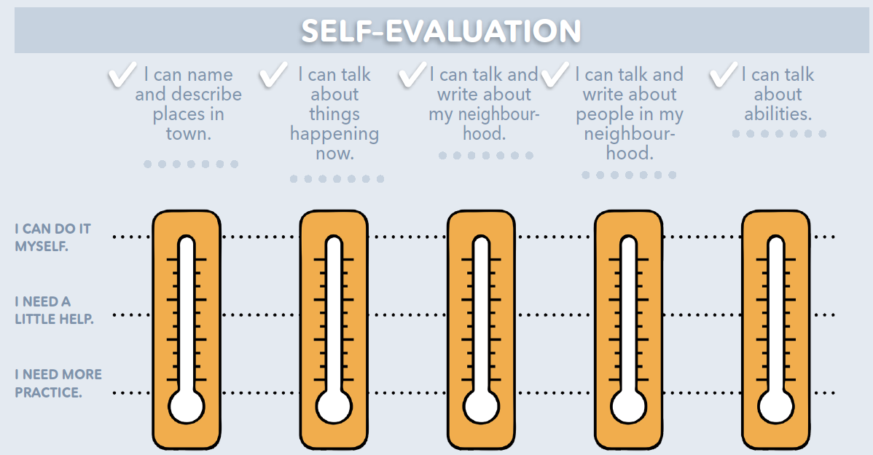
Procijeni vlastito znanje uz listu za samoprocjenu:
Znam govoriti o radnjama koje se odvijaju upravo sad.
Znam govoriti i pisati o ljudima iz svog susjedstva.
Znam govoriti o svojim vještinama (što znam/mogu raditi)
Mogu imenovati i opisati mjesta u gradu.
Znam govoriti i pisati o svom susjedstvu.
Mogu to samostalno učiniti.
Potrebna mi je manja pomoć.
Trebam to dodatno uvježbati.

Slide 5
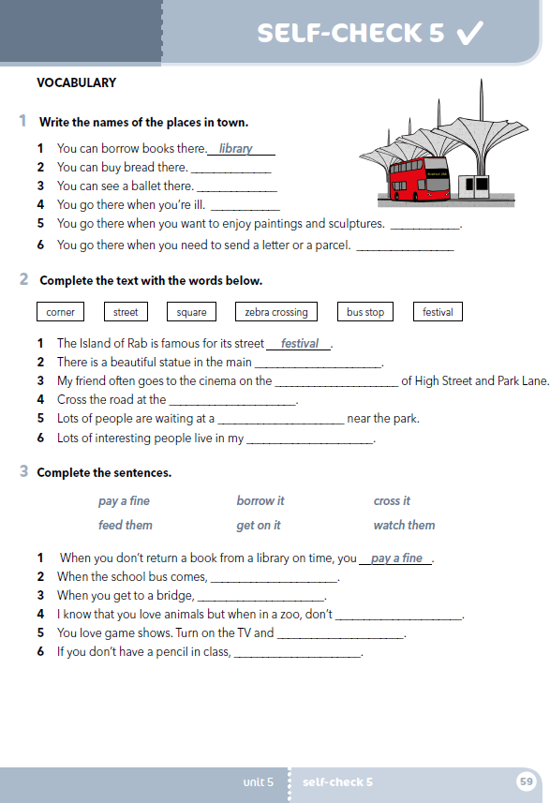
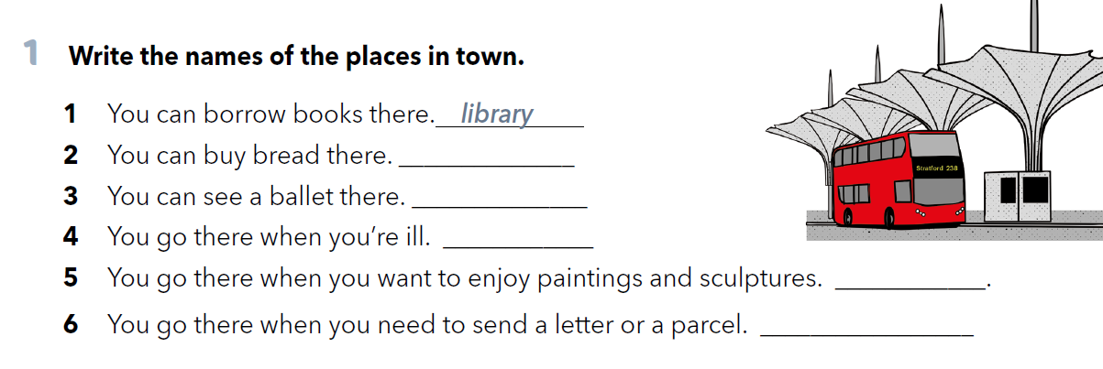
workbook p.59
bakery
theatre
hospital
museum
post office

Slide 6
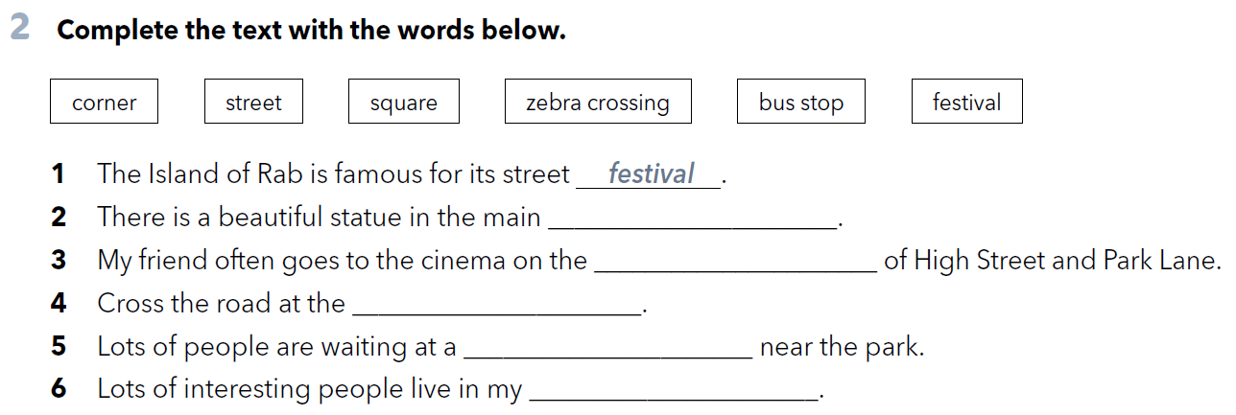
square
corner
zebra crossing
bus stop
street

Slide 7
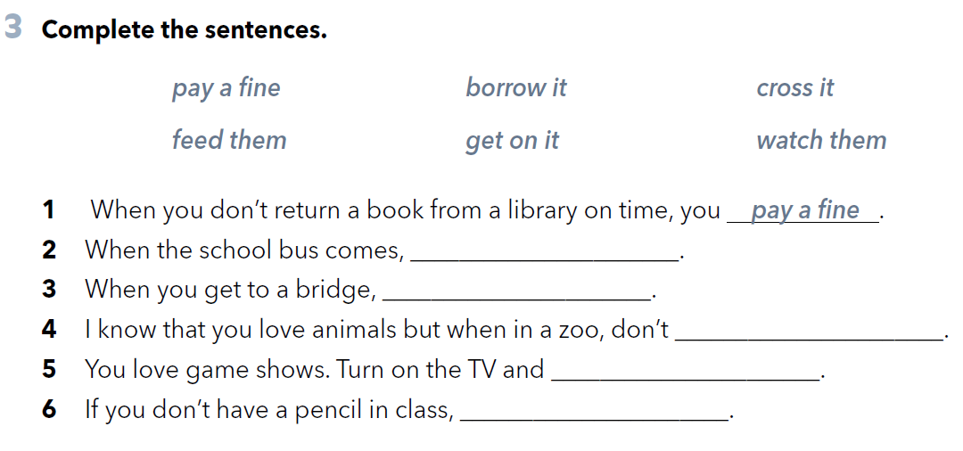
get on it
cross it
feed them
watch them
borrow it

Slide 8
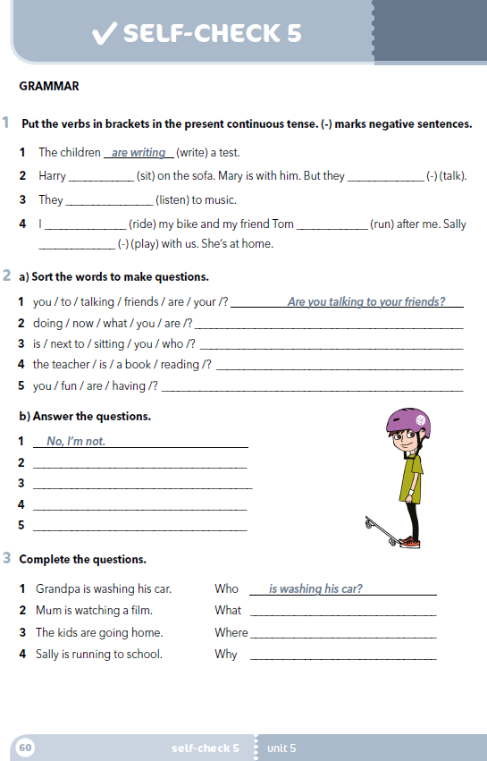
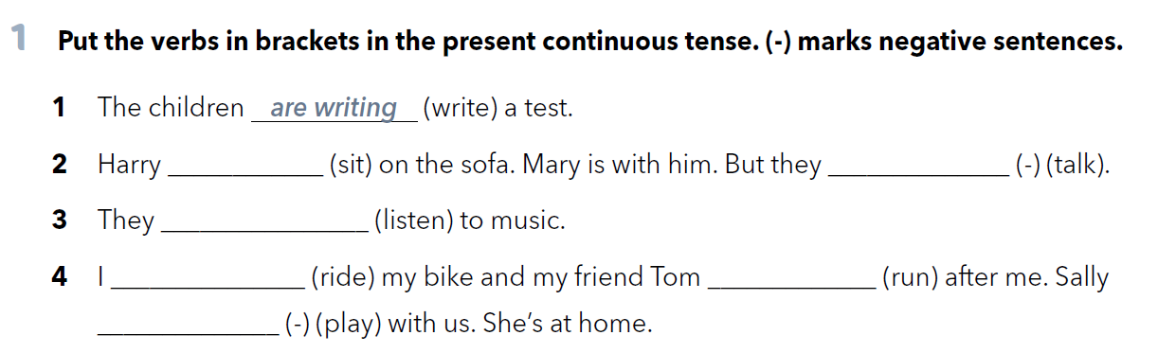
Workbook p. 60
is sitting
aren’t talking
are listening
am riding
is running
isn’t playing

Slide 9
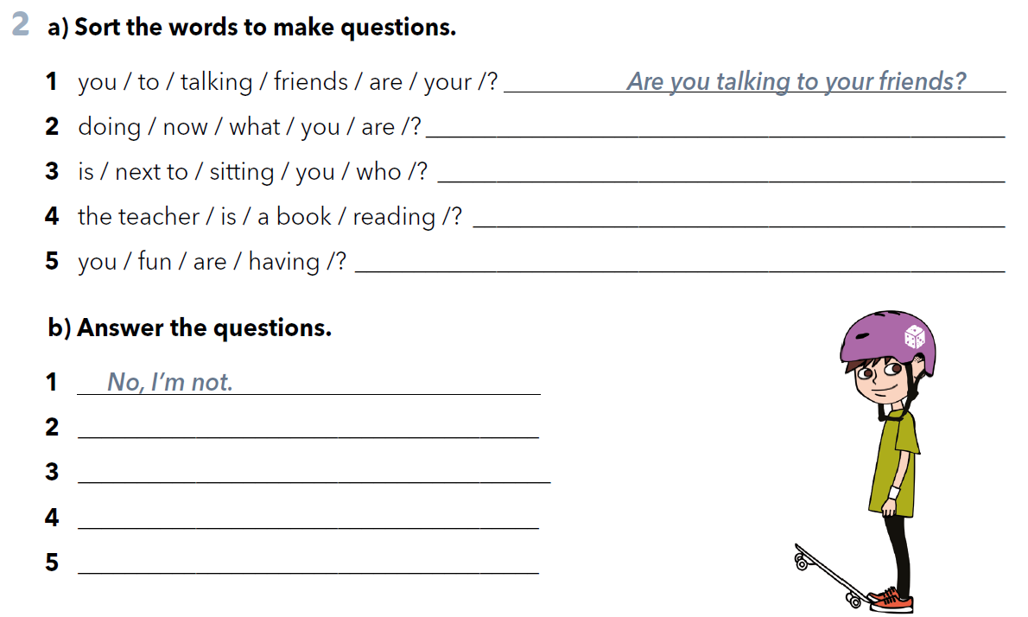
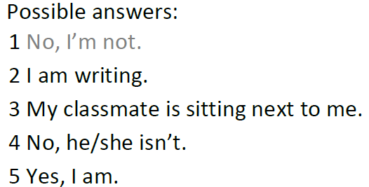
What are you doing now?
Who is sitting next to you?
Is the teacher reading a book?
Are you having fun?

Slide 10
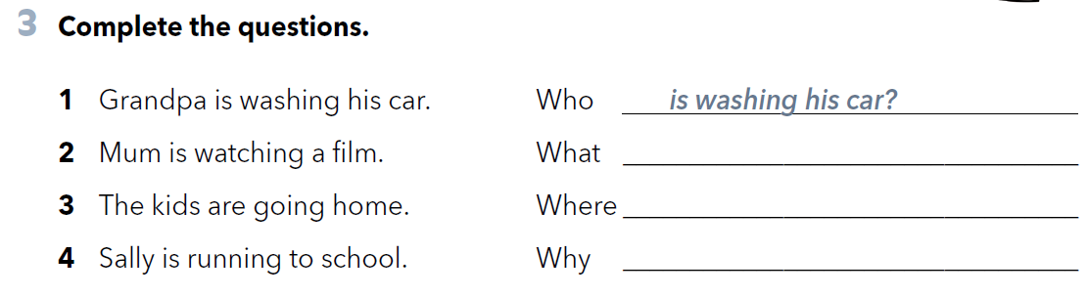
is mum watching?
are the kids going?
is Sally running to school?

Slide 11

Check your knowlewdge
https://www.e-sfera.hr/dodatni-digitalni-sadrzaji/229b3aa9-27cf-4ebc-81b2-6a298a6f213a/

